Slide 1
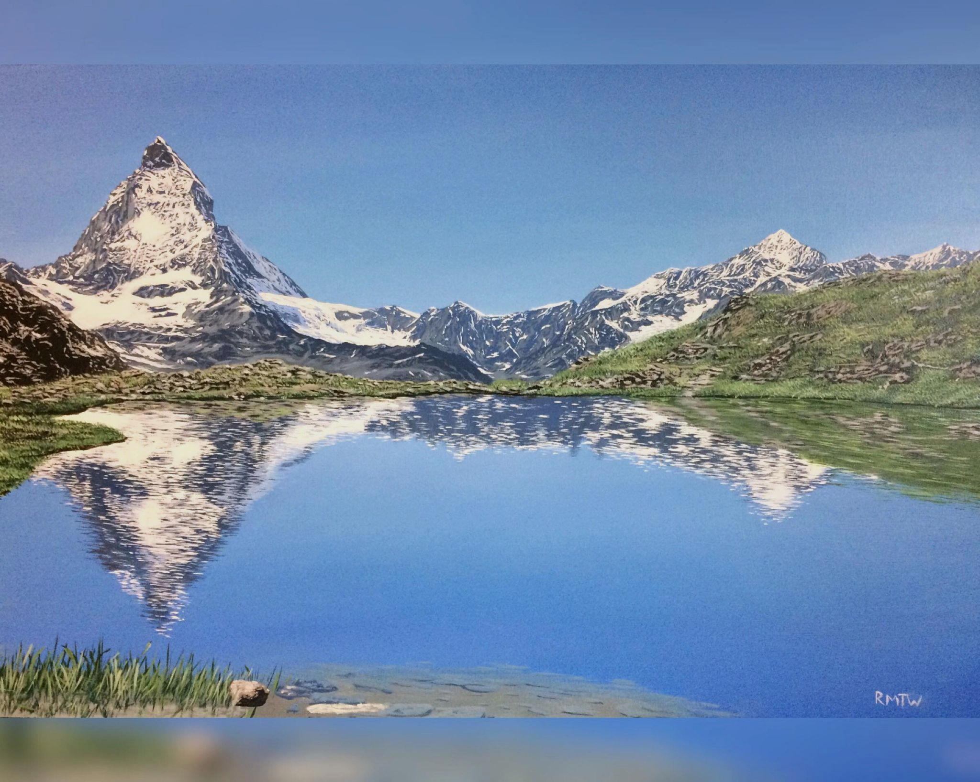
Photorealism in
Landscape Painting

Slide 2
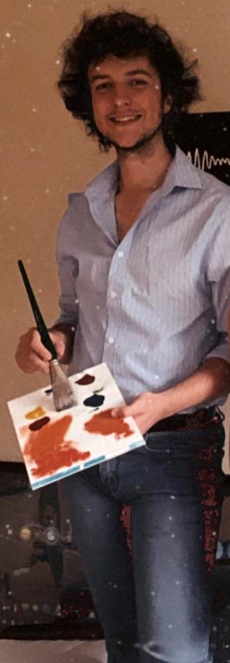
A bit about me
Started painting out of high school
Retired a few years ago
Won a few awards, gallery-represented
Painted in a few different media, on different media, with different tools
Arguably self taught
Initially learnt from Bob Ross videos on YouTube
I paint in photorealism, but this hasn’t always been the case
Paint landscapes, but have dabbled in other material too
Painting #1 – 16x20” Oil on Canvas

Slide 3
Outline of this talk
Rough progression of my art
What makes a good painting (in my opinion)
What makes a good painting
How I attack a painting (gently)
Painting #6 – 16x20” Acrylic on Canvas

Slide 4
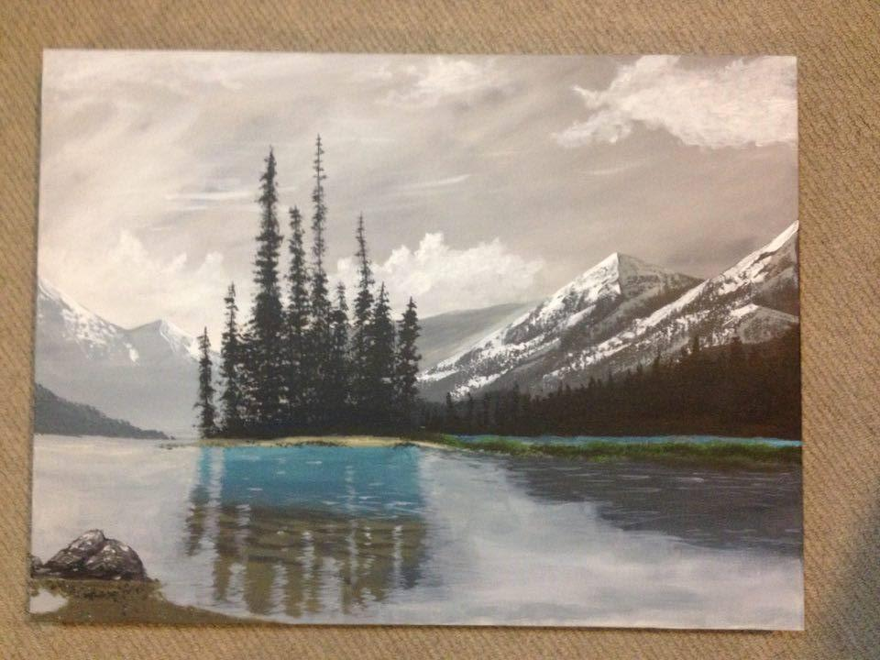
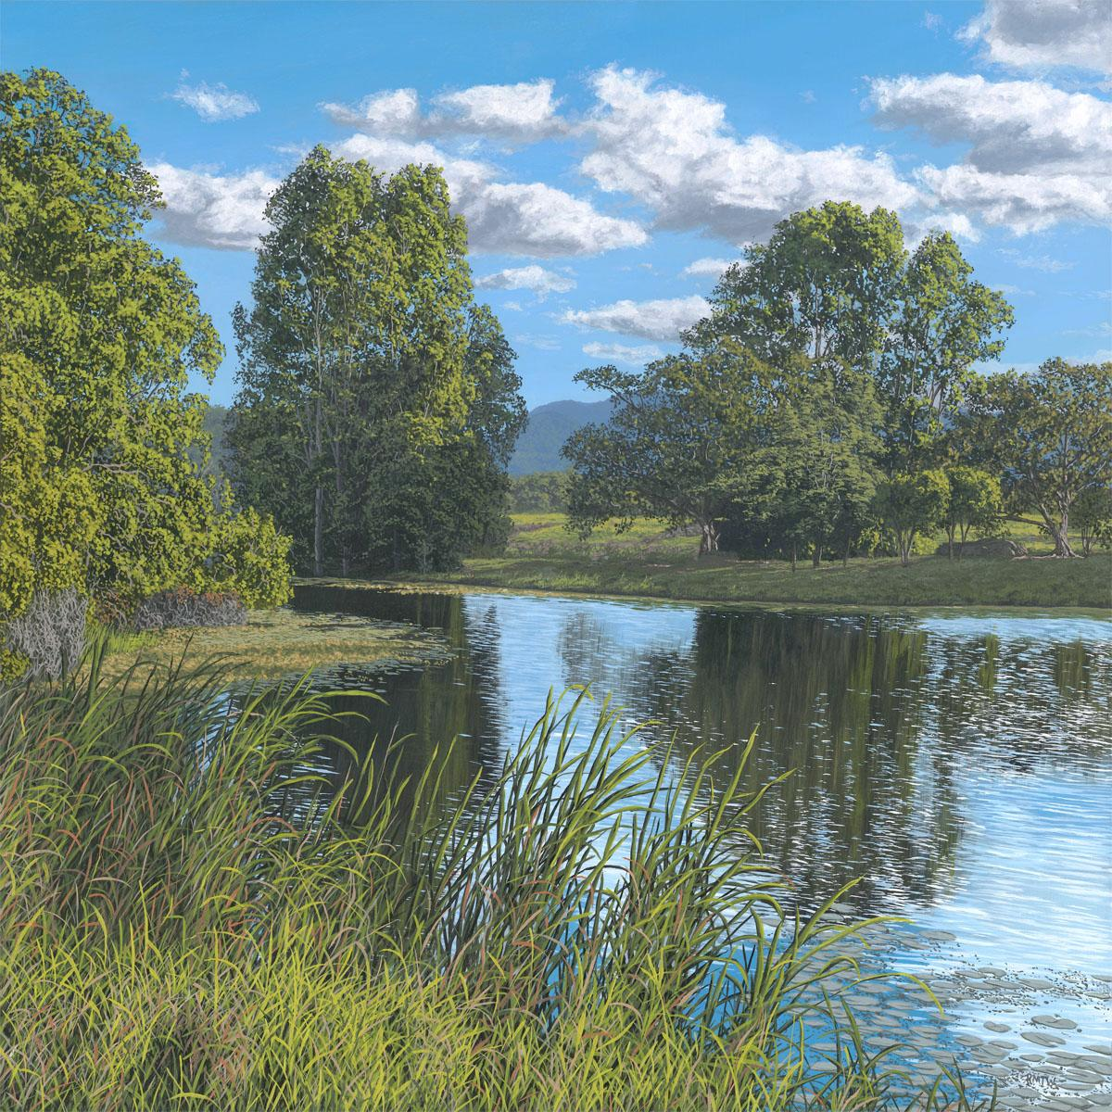
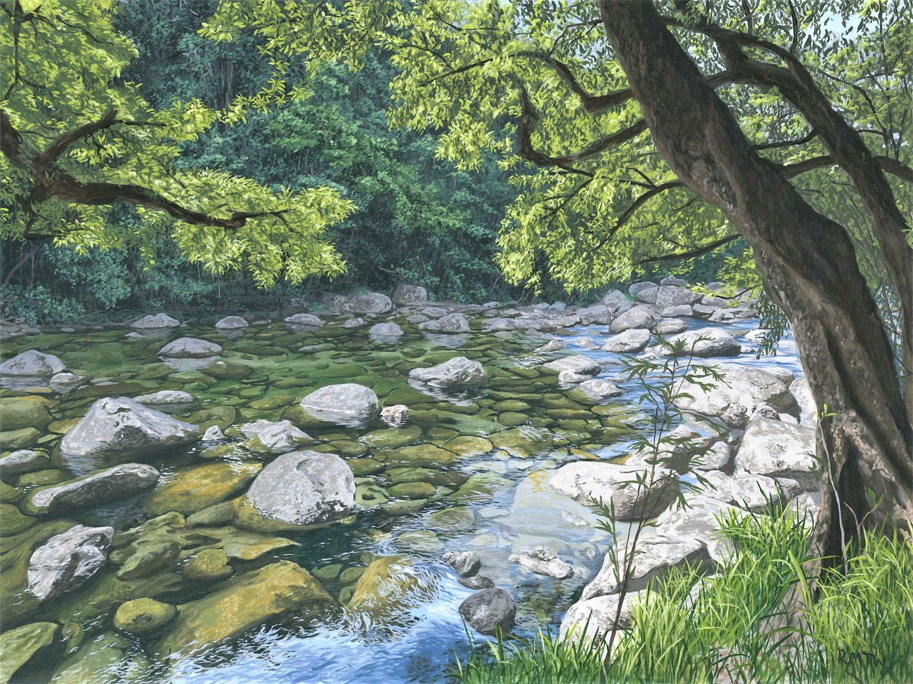
Timeline of paintings
#1
#11
#26
#76
#68
#46

Slide 5
Structure of a good painting — which is better?
#41 – 7x9” Acrylic on Canvas
#52 – 30x40cm Oil on Panel

Slide 6
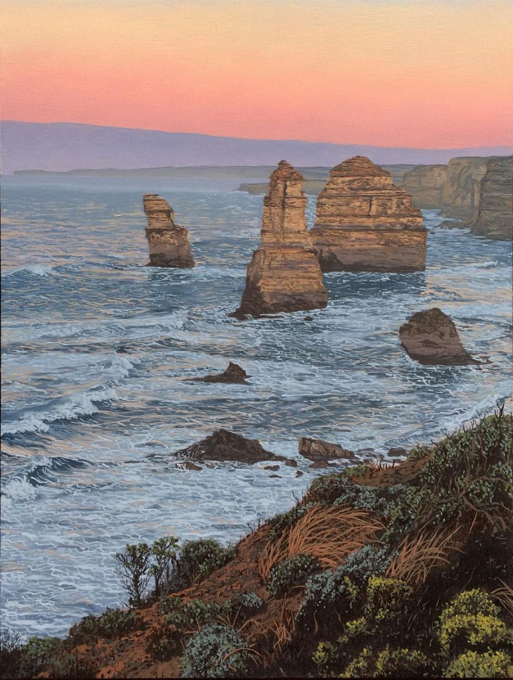
Structure of a good painting — which is better?
A lot more determines a good painting than just detail!
Need to pay attention to:
Contrast (depth)
Colour
Direction and framing
Rule of thirds
Generally in photorealism, the reference is the hardest part
Expensive
Random chance
Time consuming
#80 – 24x36cm Oil on Panel

Slide 7
Structure of a good painting — depth/contrast
Distance
Order
The atmosphere helps with depth
When painting, best to work back to front
Generally need strong depth to convey scale and structure

Slide 8
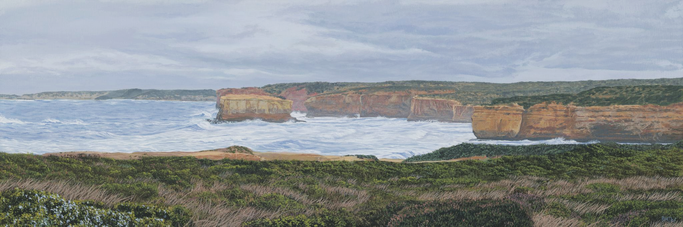
Structure of a good painting — depth/contrast
Distance
Order
#70 – 20x60cm Oil on Panel

Slide 9
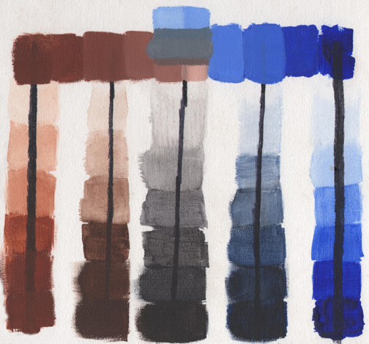
Structure of a good painting — colour
Can make natural shades with just two colours and white
Generally want muted, but not unsaturated colours
Using a small, limited palette means harmony
Never use paints straight out of the tube!
Source: Robert Masla

Slide 10
Structure of a good painting — colour
#40 – 16x24” Acrylic on Canvas

Slide 11
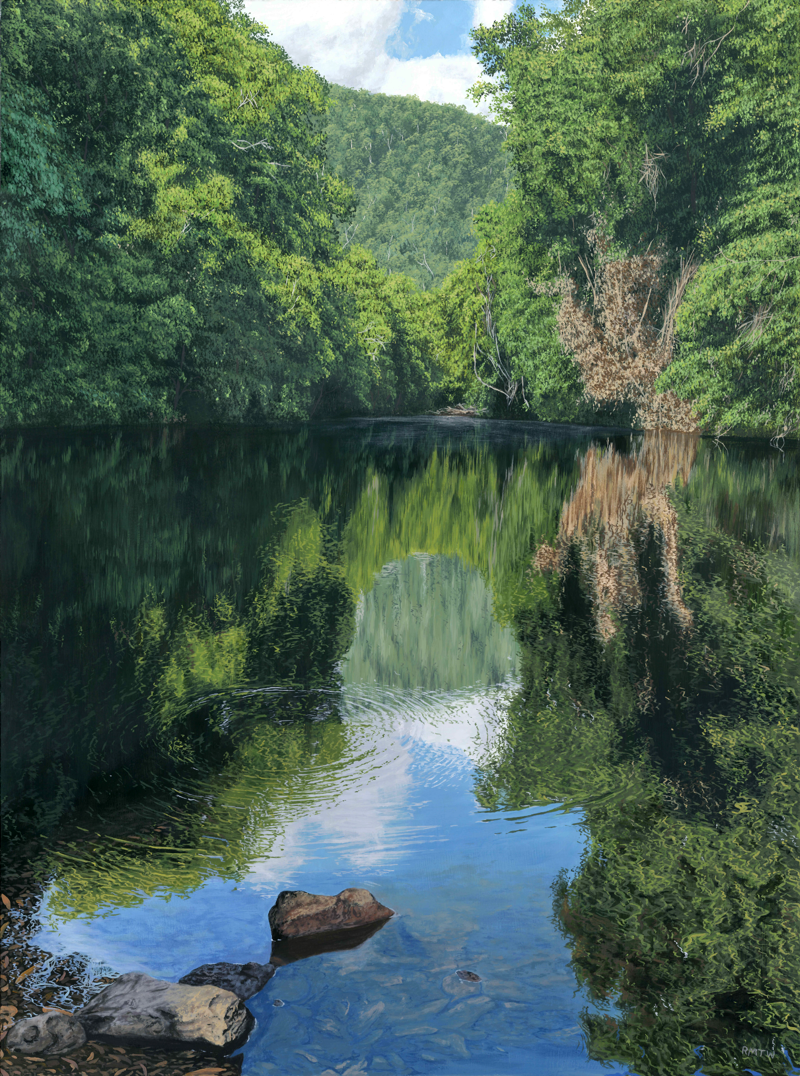
Structure of a good painting — colour
#72 – 45x60cm Oil on Board

Slide 12
Green sucks!

Slide 13
Structure of a good painting — direction/framing
Ideally, elements of a painting lead focus to a focal point
Focal points (usually) look best at a `third’ in a painting
Modifying a painting/reference takes creativity and/or photoshop savvy
Unfortunately I have neither

Slide 14
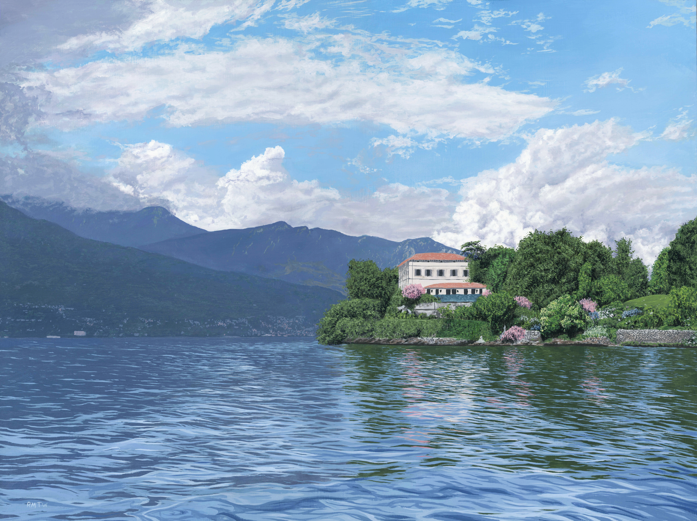
Structure of a good painting — direction/framing
#69 – 45x60cm
Mixed Media on Panel

Slide 15
Structure of a good painting — direction/framing
#69 – 45x60cm
Mixed Media on Panel

Slide 16
Structure of a good painting — direction/framing
#69 – 45x60cm
Mixed Media on Panel

Slide 17
Structure of a good painting — reference
Photorealism (in landscapes) is about painting nature as it is, not how we’d like it to be
In most cases, paint directly from a reference
In some cases, some massaging of the `truth’ is needed

Slide 18
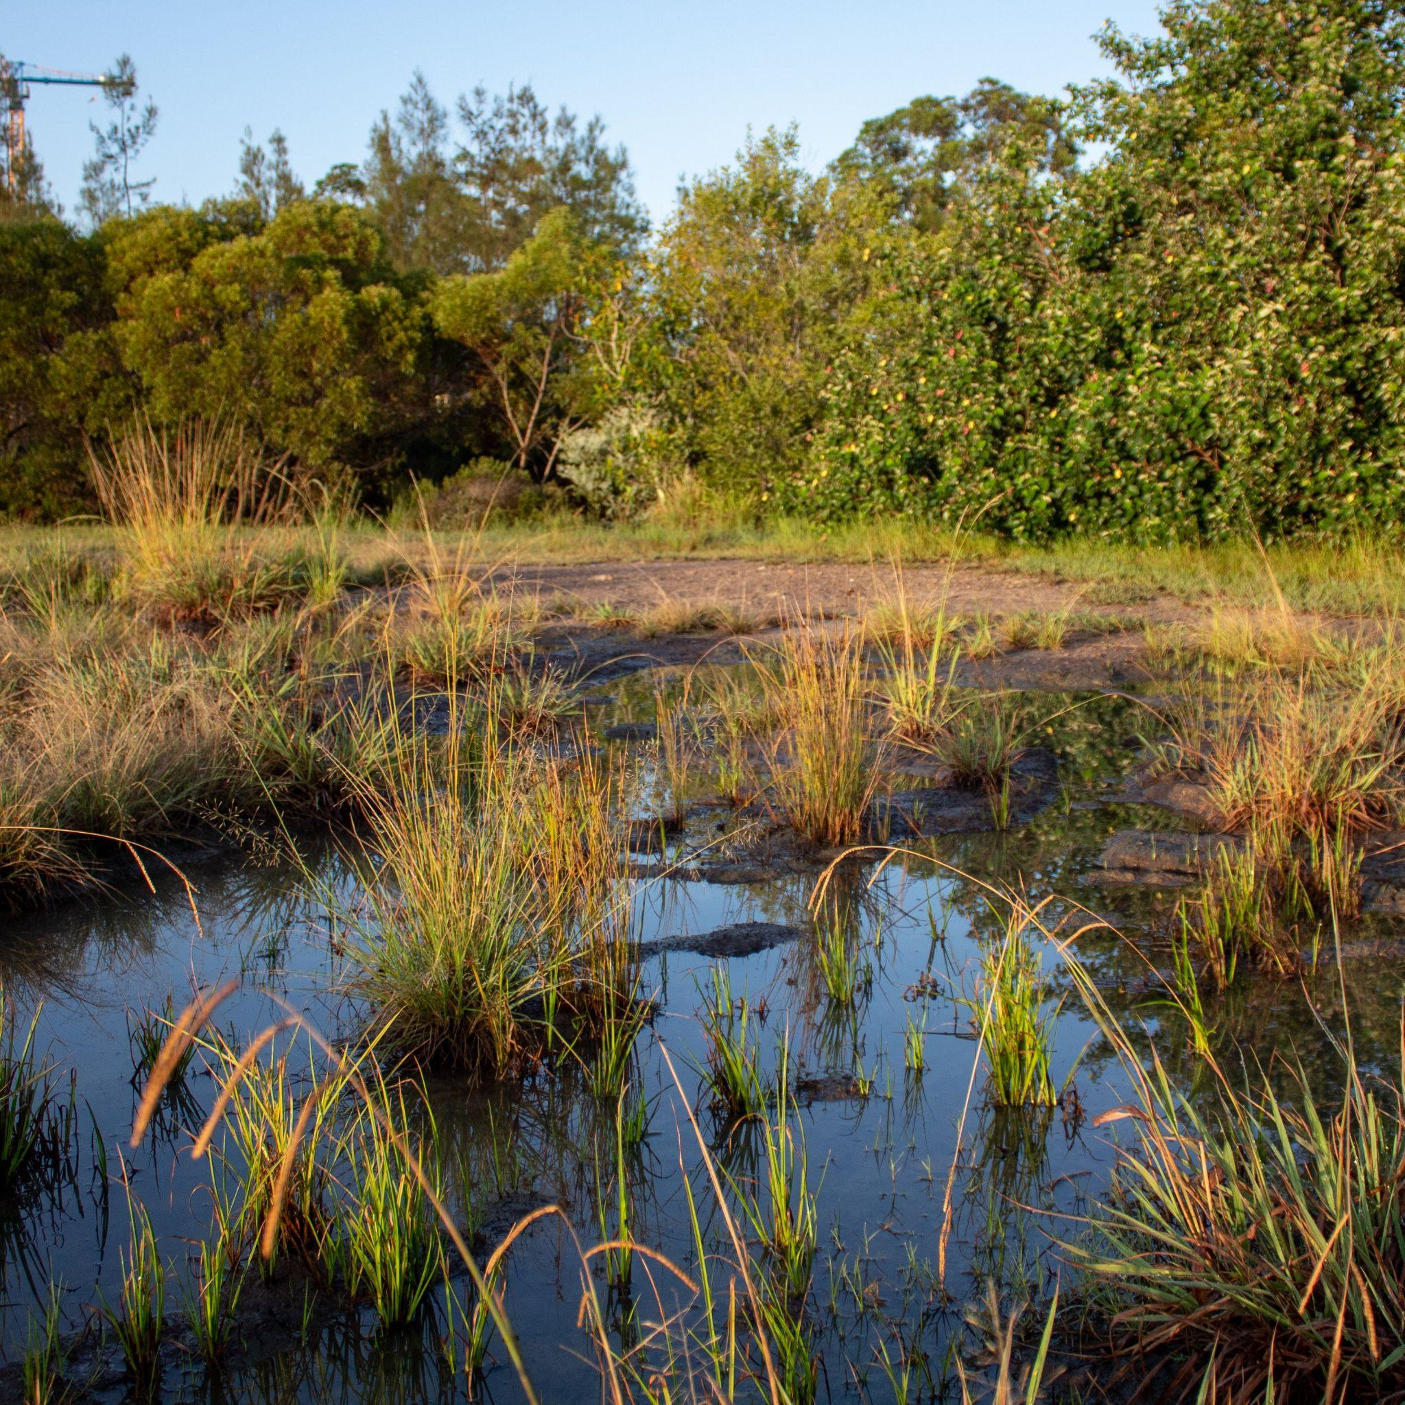
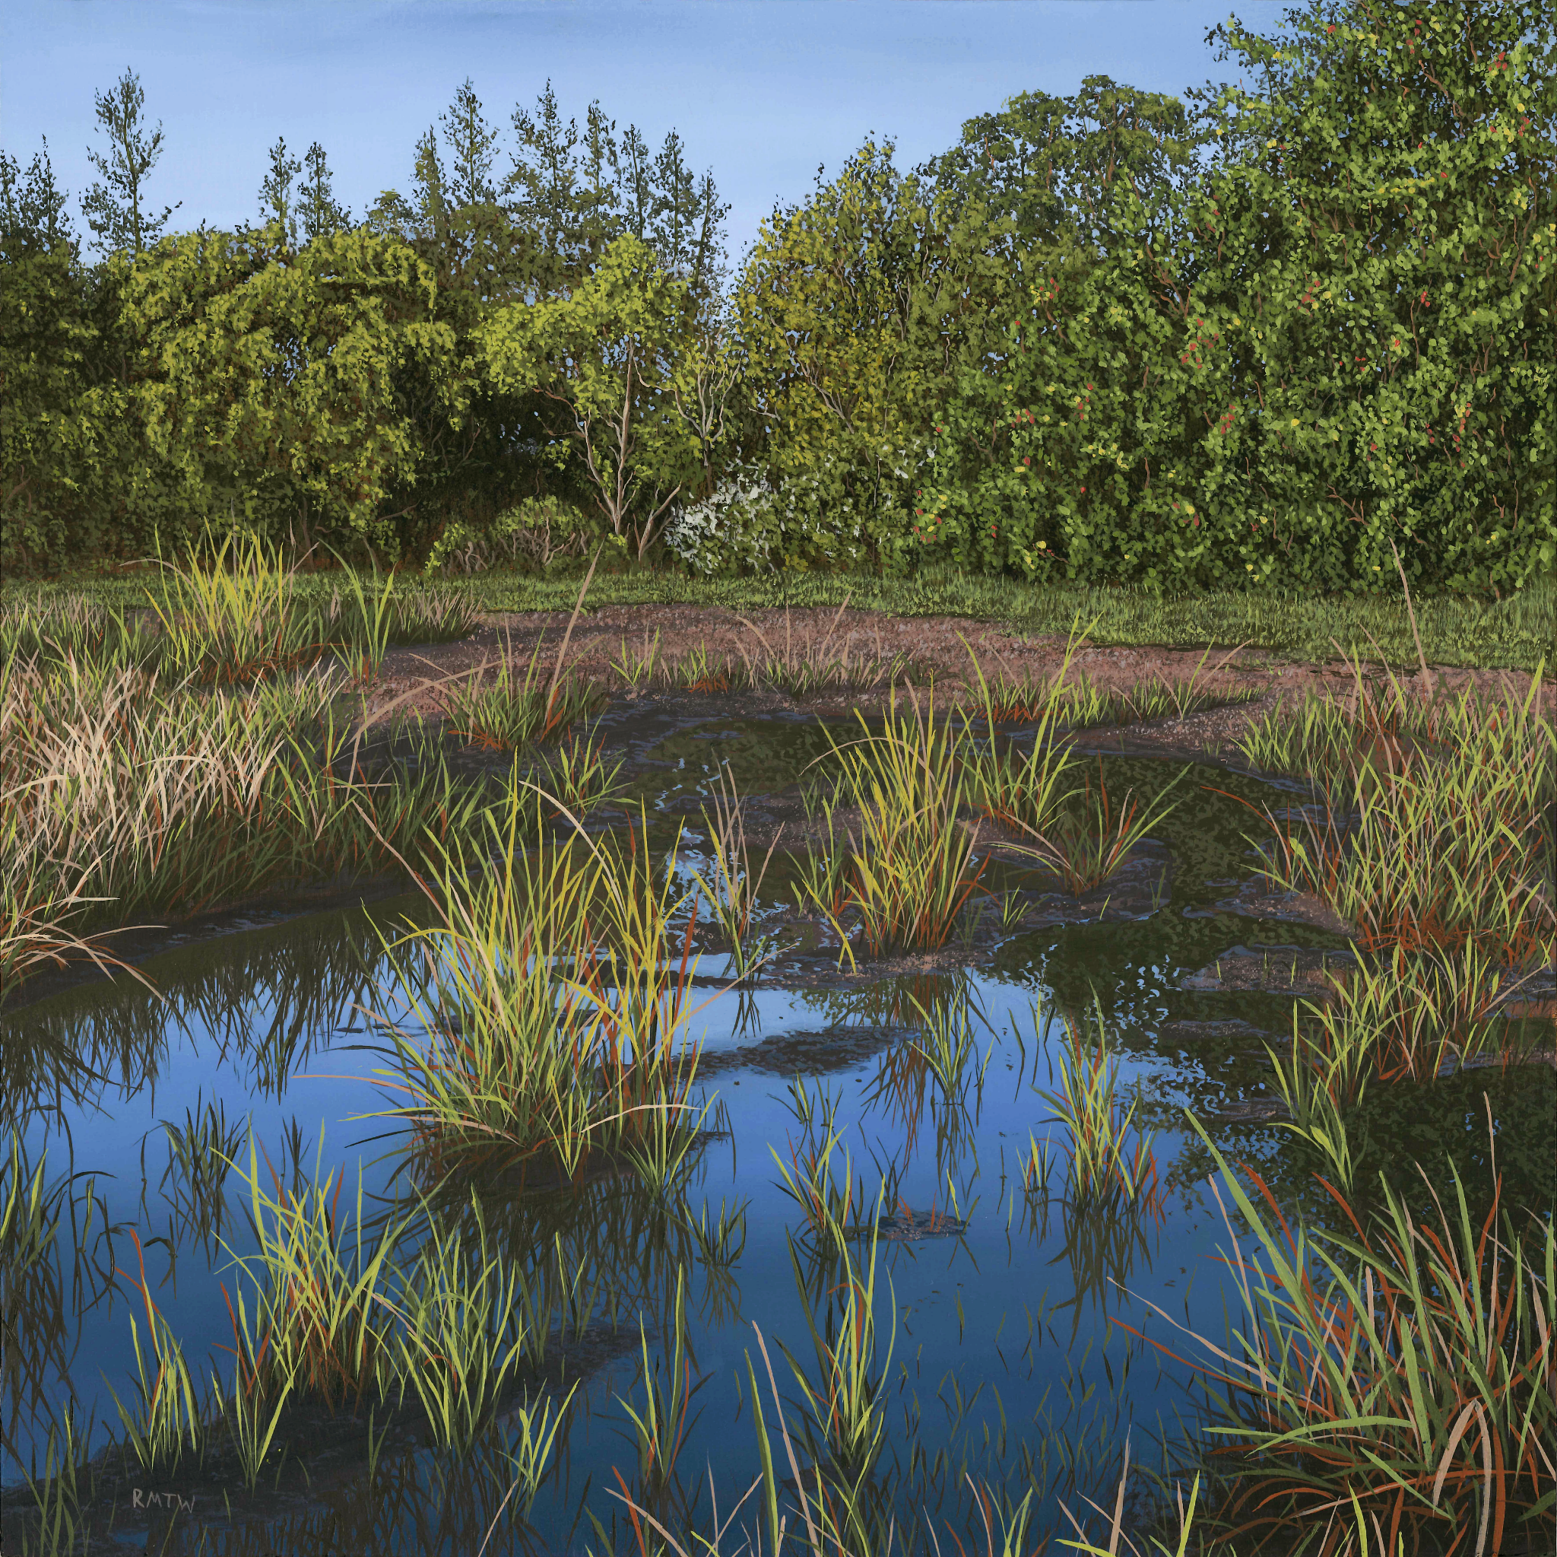
Structure of a good painting — reference
Robina, Gold Coast after a storm the night before
#73 – 30x30cm Oil on Panel

Slide 19
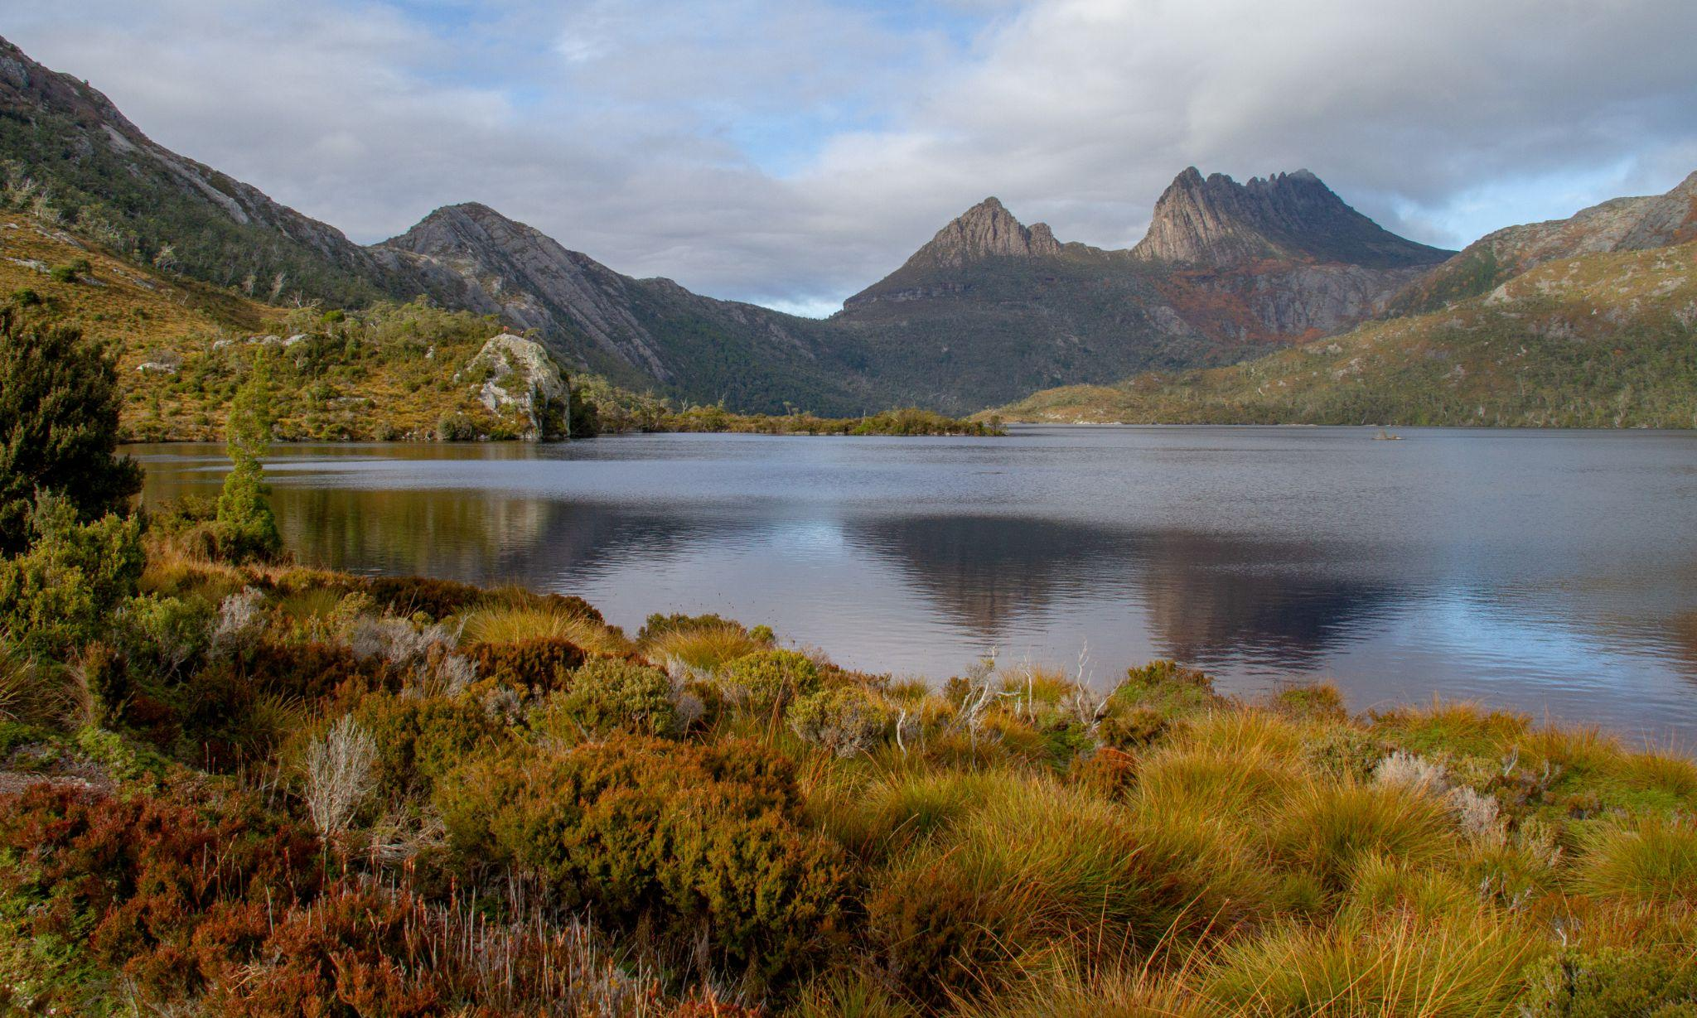
Structure of a good painting — reference

Slide 20
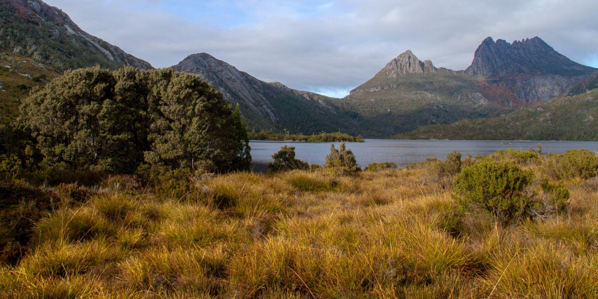
Structure of a good painting — reference

Slide 21
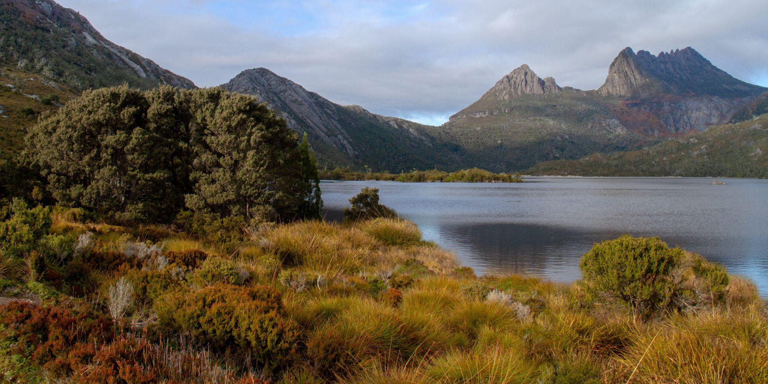
Structure of a good painting — reference

Slide 22
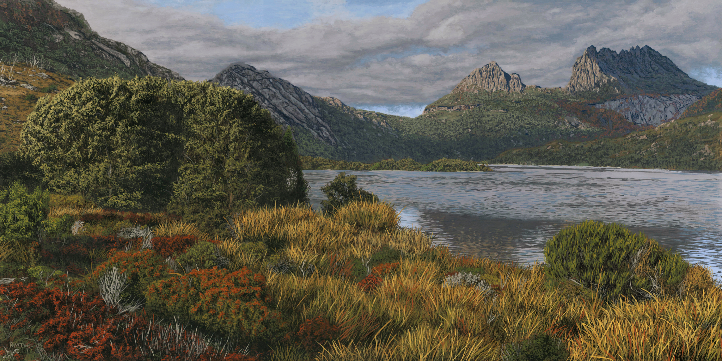
Structure of a good painting — reference

Slide 23
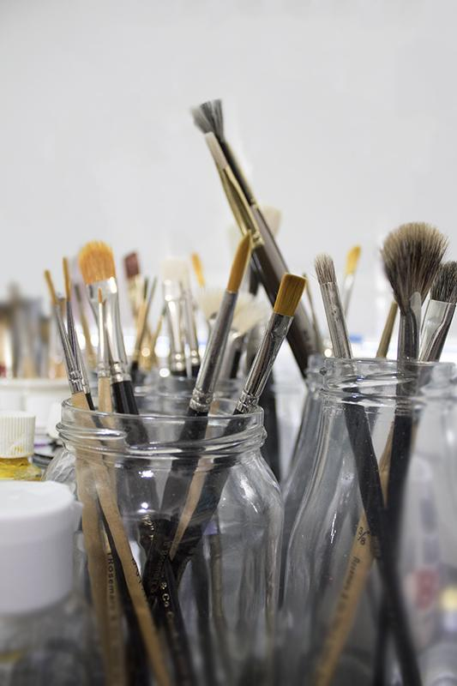
What makes a good painting
Lots of tools are involved!
Brushes
Canvas/boards
Paints
Laptop/tablets
So. Many. Cleaning supplies.
Something to keep you sane (snacks, music, pets!)
Cameras and editing software

Slide 24
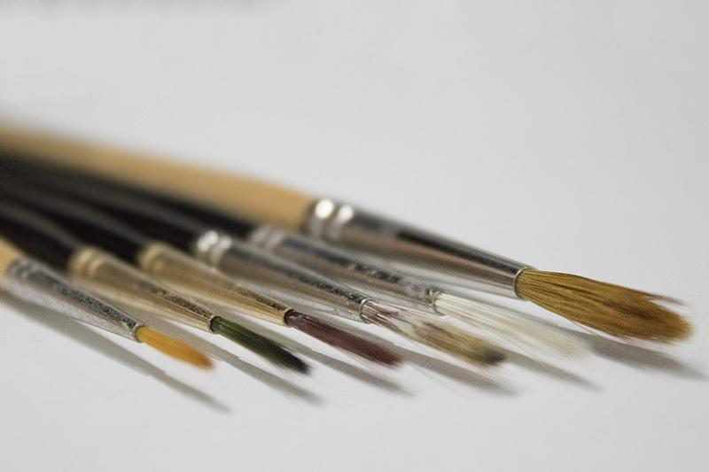
What makes a good painting — brushes
Different brushes for different jobs
Smaller brushes for more detail
Softer hairs for more flow and even stroke
Stiffer hairs give more complexity and random structure
Better brush = better painting

Slide 25
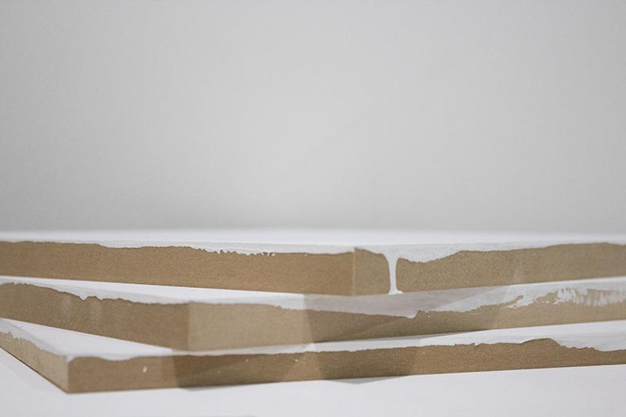
What makes a good painting — panel/canvas
Canvas is fine, and cheap – made from cotton
Linen is the gold standard, and very expensive – made from flax plant fibres
Painting directly on wooden board is becoming more common
The smooth surface is ideal for sub-millimeter detail
Requires a lot of preparation to be archival
The picture below is not good!

Slide 26
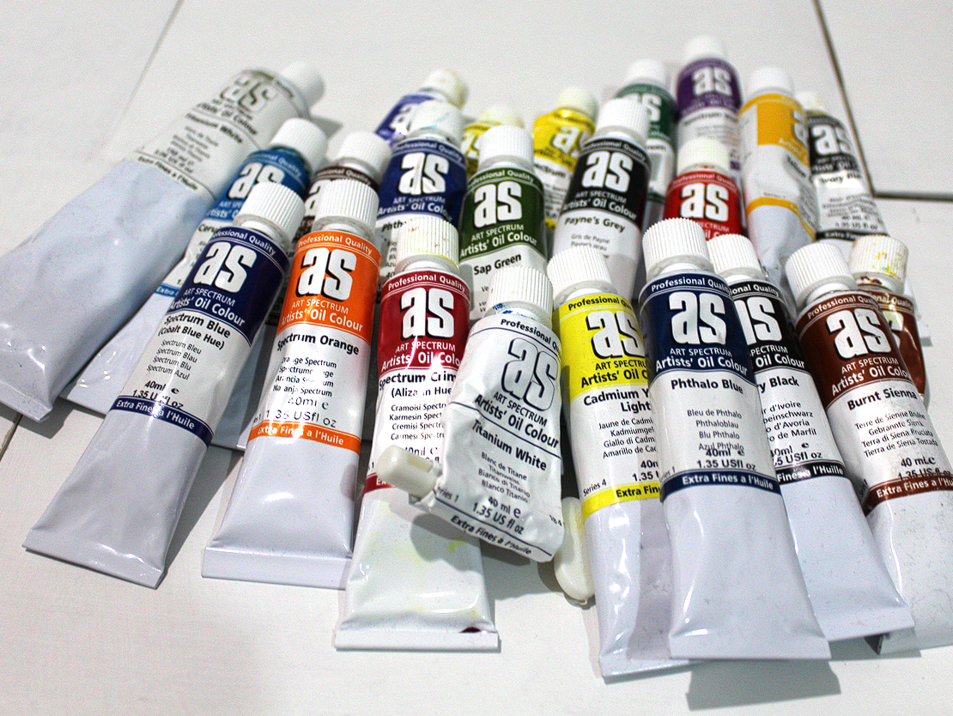
What makes a good painting — paints
Paint is composed of a binding agent, and a pigment (the colour)
Pigments can be natural, or synthetic
Depending on the brand/pigment, paints can have different consistency and opacity
Student grade paints are cheap, but not archival. Artist grade paints generally have higher quality, and more pigment
Especially with oil paints, some additives are needed to get a desired consistency

Slide 27
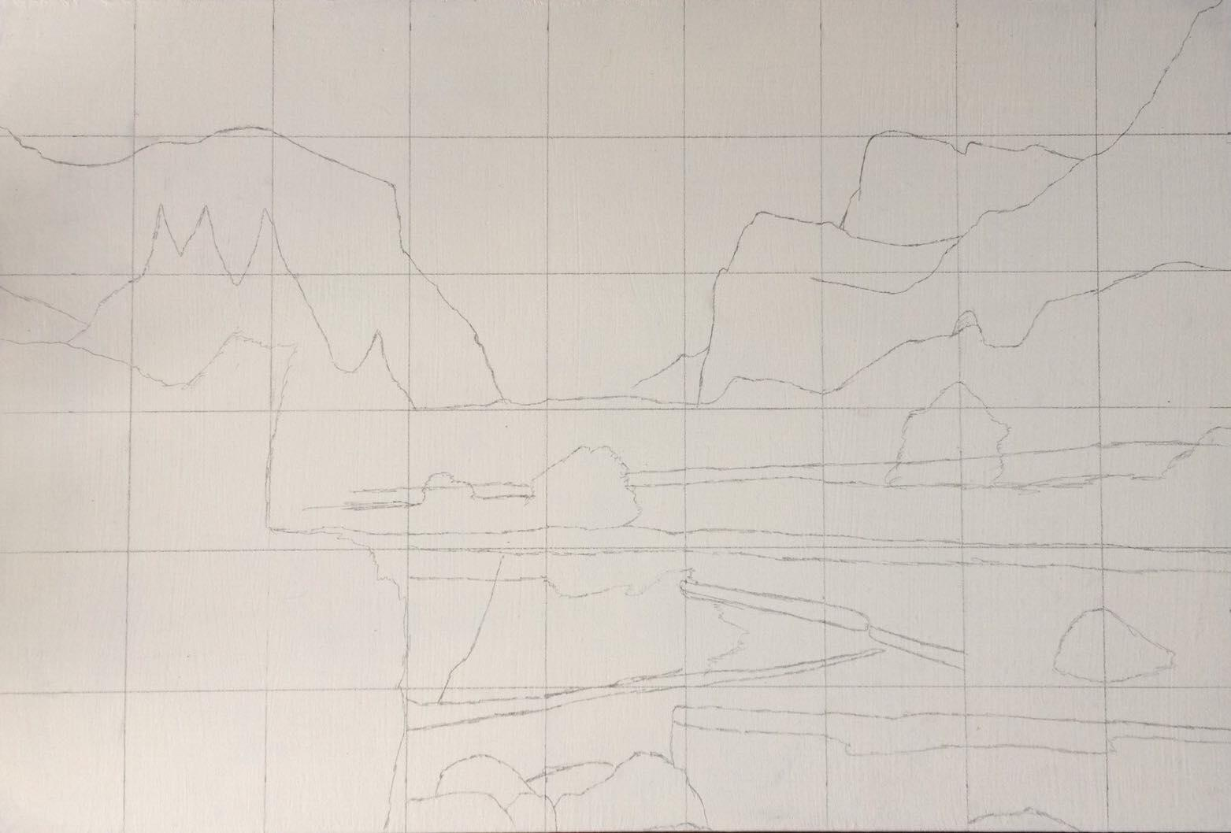
How to paint in photorealism
Step 1: Grid and sketch

Slide 28
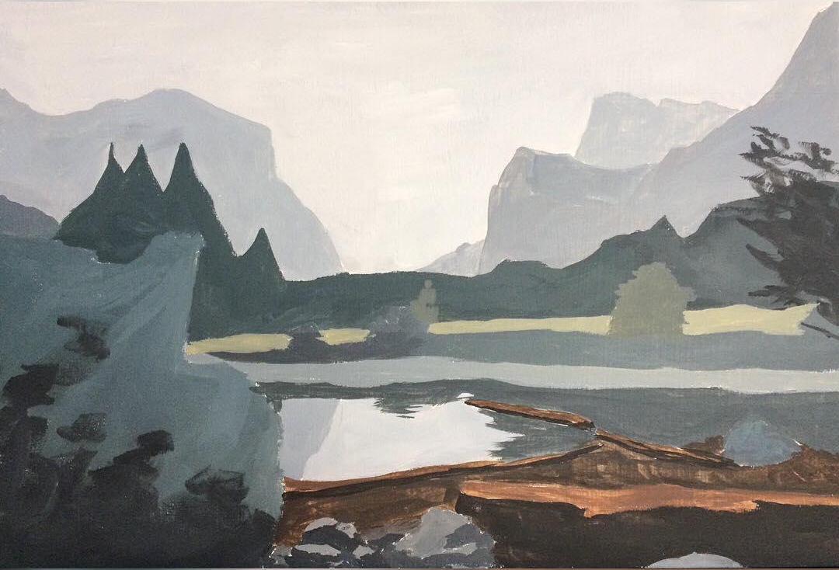
How to paint in photorealism
Step 2: Block in

Slide 29
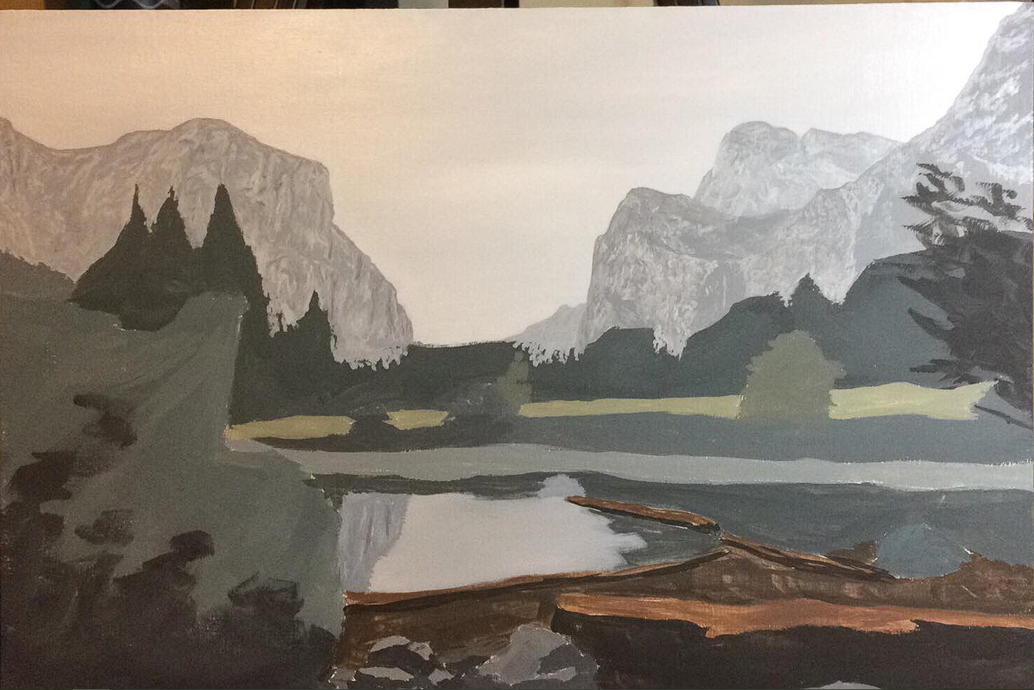
How to paint in photorealism
Step 3: Start background detail

Slide 30
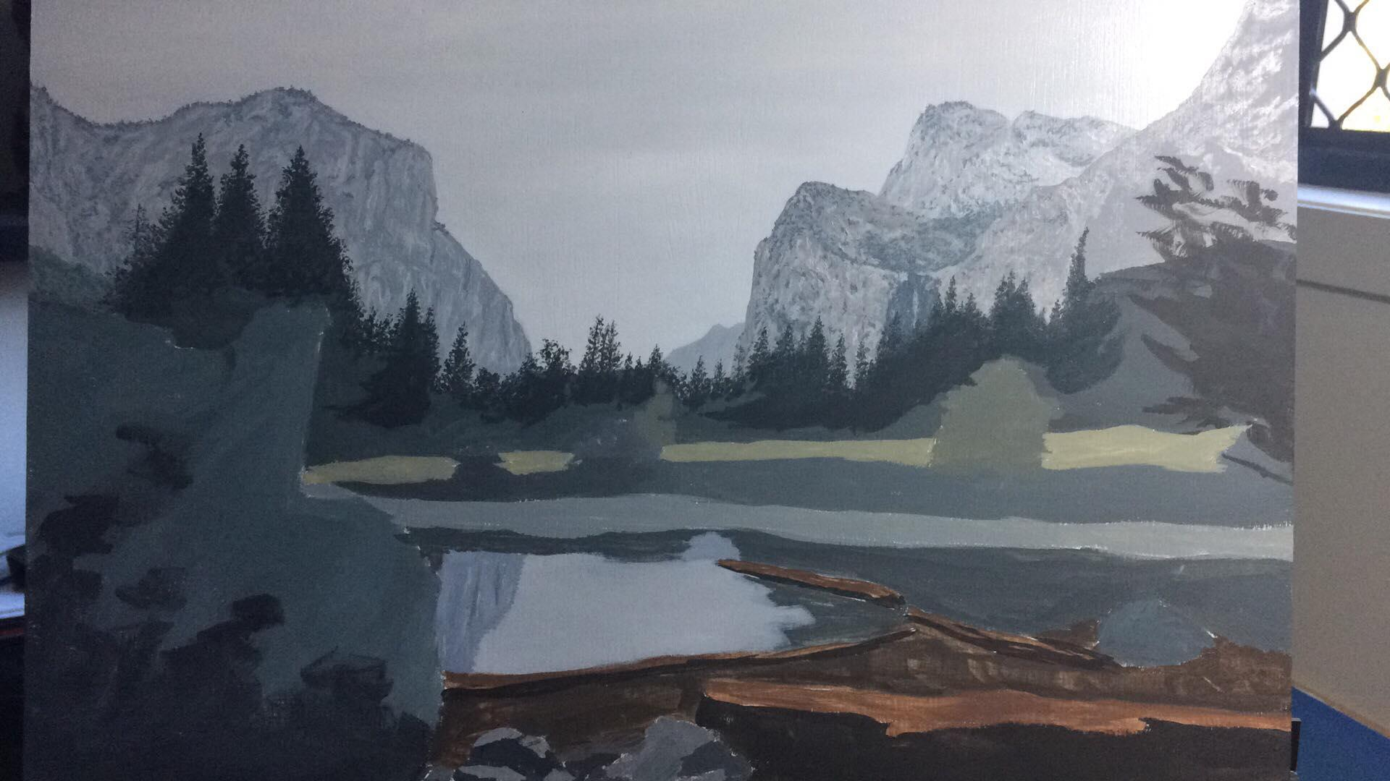
How to paint in photorealism
Step 4: Start midground detail

Slide 31
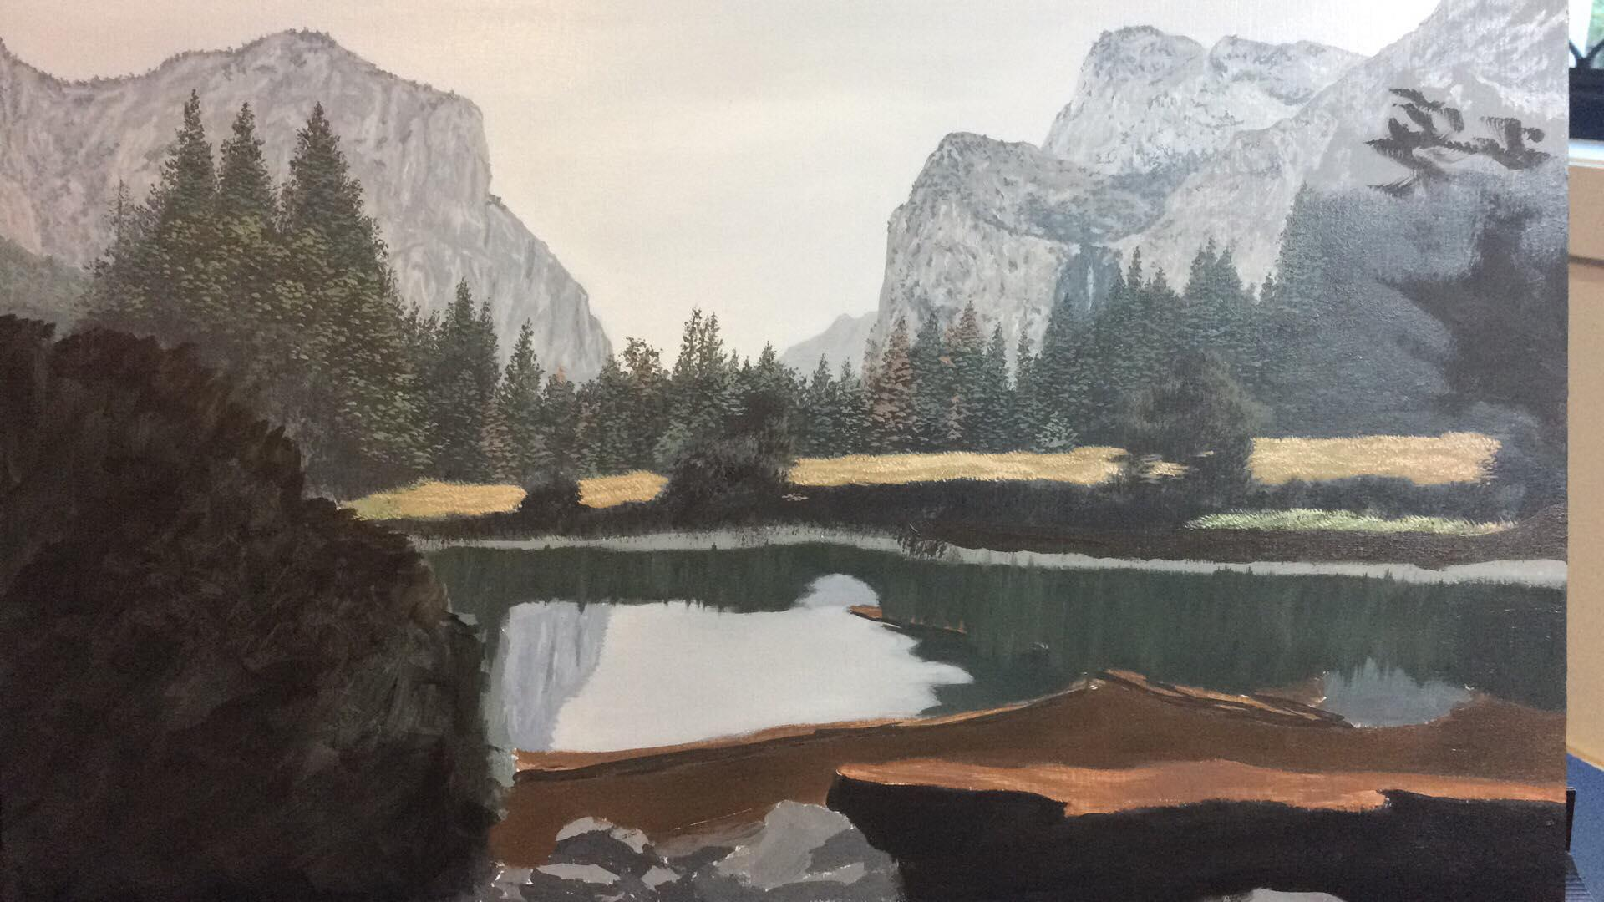
How to paint in photorealism
Step 5: Start foreground detail

Slide 32
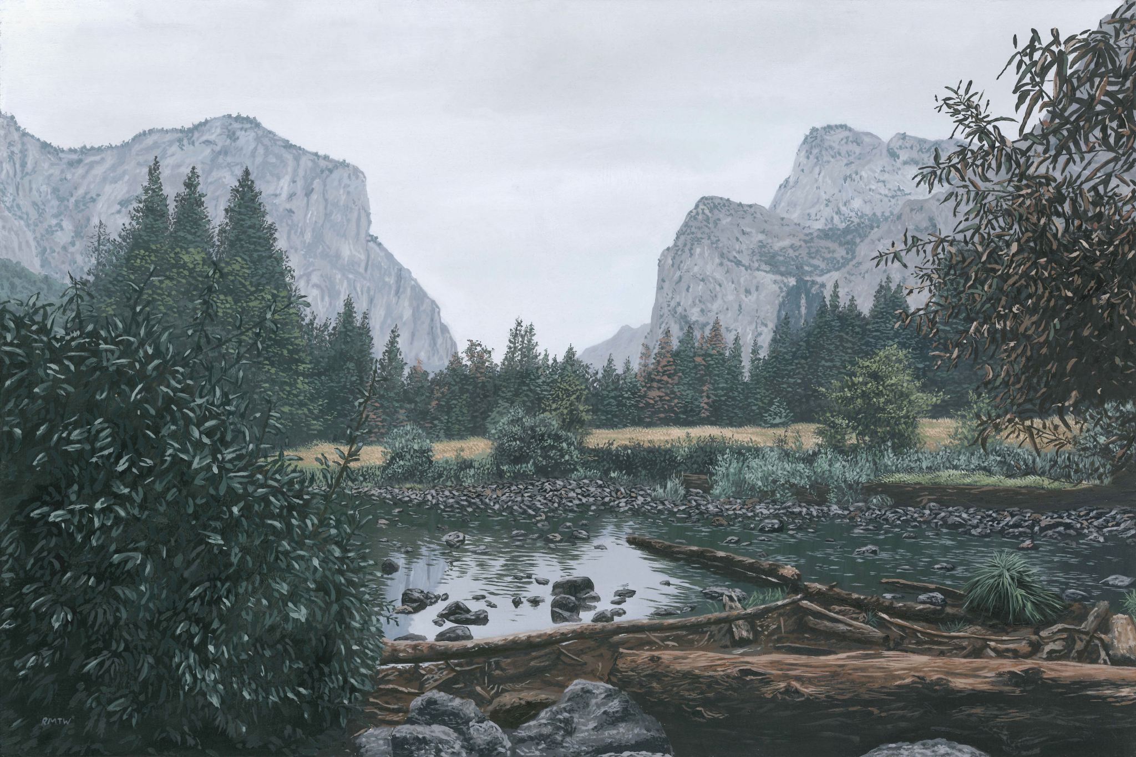
How to paint in photorealism
#62 – 30x45cm Oil on Panel

Slide 33
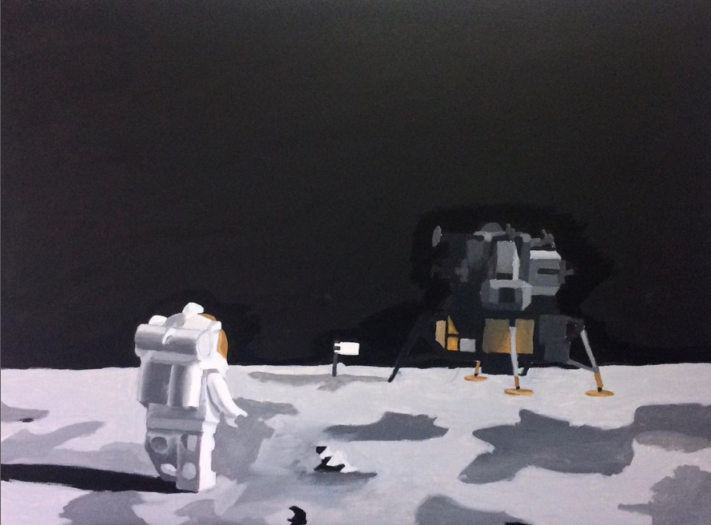
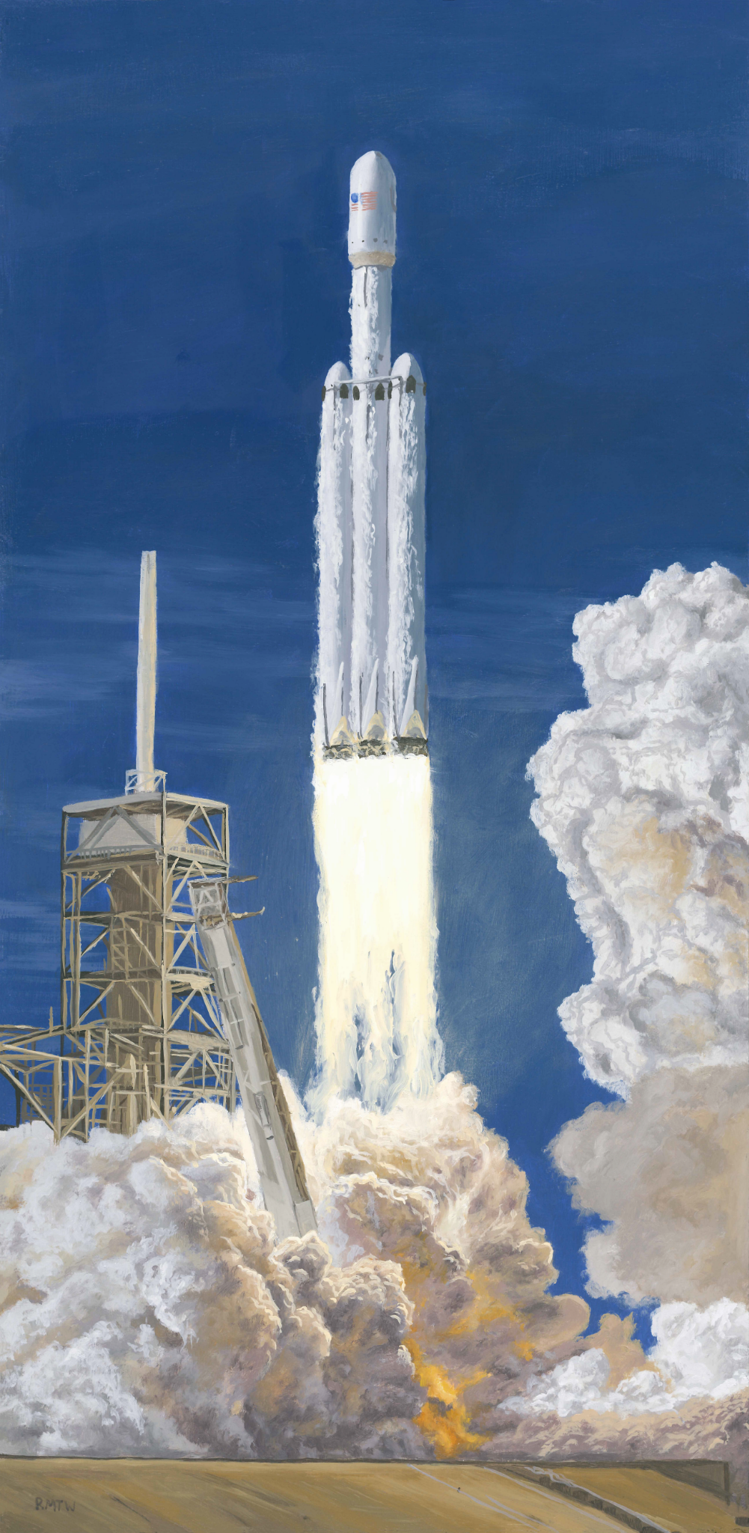
Some non-`landscape’ attempts
Unfinished – Blocked In
#38 – 18x24” Acrylic on Canvas
#49 – 30x40cm Acrylic on Panel
#31 – 16x20” Acrylic on Canvas
#78 – 45x22cm Oil on Panel

Slide 34
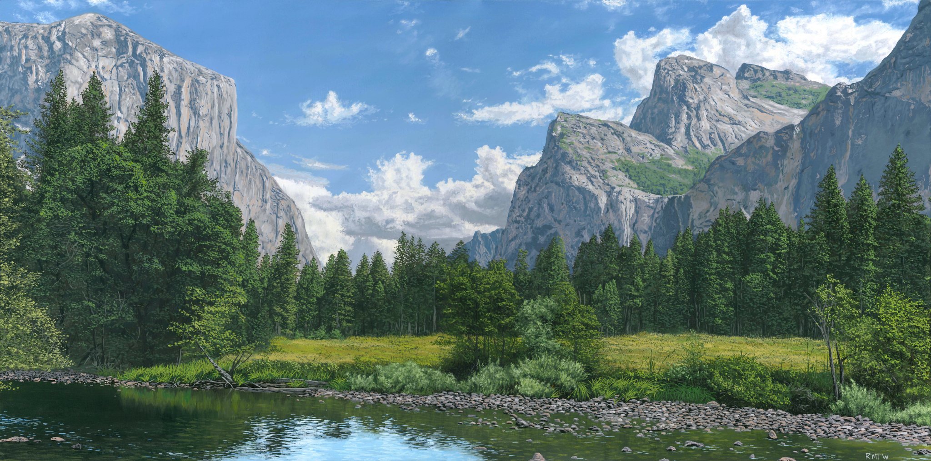
Thanks for listening!
#64 – 30x60cm Oil on Panel

